Slide 1

Zomato data analysis for opening new restaurants
Submitted by Sukhendu Senapati

Slide 2
Introduction
This presentation will help us to take decisions for opening of new restaurants.
We will use the data of 15 countries for 9 years from 2010 to 2018.
My analysis shows several strategic requirements for the opening of new restaurants.
By analyzing the data of multiple locations, it is possible to identify countries with strong demand & minimum competition.
The parameters that we have used for analysis are no. of restaurants, expenditure, cuisines, ratings etc. to get insights.

Slide 3
Problem Description
Countries where the team can open newer restaurants with lesser competition.
Cities in the suggested countries suitable for opening restaurants..
What is the current quality regarding ratings for restaurants that are open in suggested countries?
Current expenditure on food in the suggested countries.
restaurants from the recommended states that are our biggest competitors and also those that are rated in the lower brackets, i.e. 1-2 or 2-3.
Which cuisines should we focus on in the newer restaurants to get better feedback? Does the choice of cuisines affect the restaurant ratings?
According to our current data, should we go for online delivery and table booking? Does that affect the customer’s ratings?
Should the team keep the rate of cuisines higher? Will that affect the feedback? According to our data are the rates of cuisines and ratings, correlated?

Slide 4
Assumption
Where multiple cuisines are merged, we considered the first one as cuisine category for our analysis. A new column named ‘cuisines updated’ has been added for this.
We converted Average_cost_for_two in dollar value so that we can compare expenditure of multiple countries.
Based on average cost we created 4 buckets named ‘$0 to $10’, ‘$10 to $20’, ‘$20 to $40’, ‘> $40’.
Based on rating we created 4 category called ‘Very Bad’, ‘Bad’, ‘Good’, ‘Very Good’

Slide 5
Suitable countries to open new restaurants
We tried to find countries to open new restaurants based on following principles.
Number of restaurants present in country
Expenditure on food
Ratings of restaurants

Slide 6
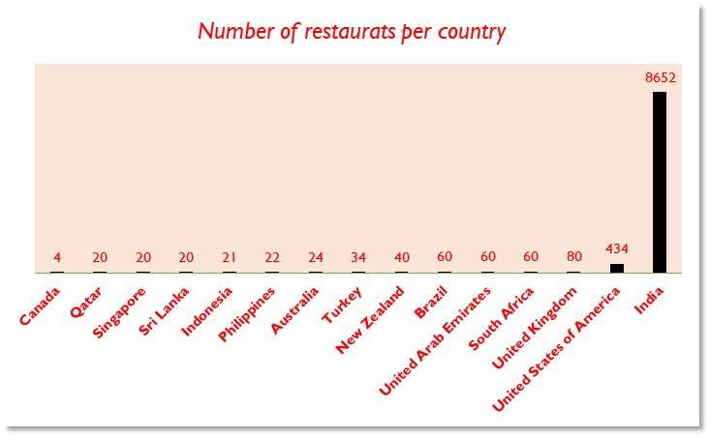
Countries based on number of restaurants
Canada
Qatar
Singapore
Sri Lanka
Indonesia
Philippines
Australia
Turkey
New Zealand
Brazil
United Arab Emirates
South Africa
United Kingdom
From the chart it is clearly visible that India & USA have most number of restaurants.
Higher number of restaurants will create more competition resulting a heavily cluttered market.
So, we will exclude India & USA.

Slide 7
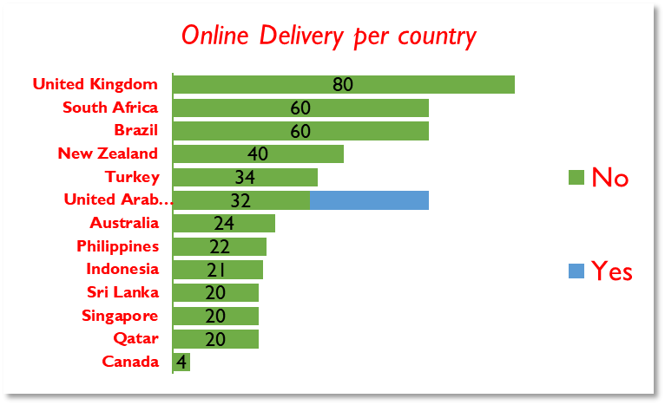
United Arab Emirates is a country where Online delivery is already available.
Opening new restaurants in UAE means facing competition from existing players.
Therefore, we can exclude UAE also

Slide 8
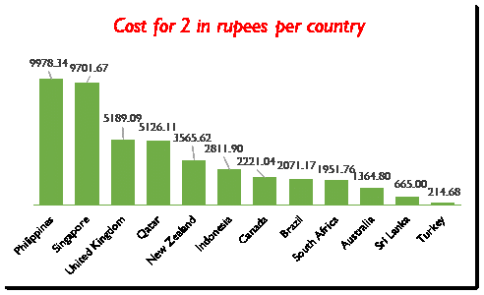
Countries left after exclusion
Canada
Qatar
Singapore
Indonesia
Philippines
Australia
New Zealand
Brazil
South Africa
United Kingdom
From the chart it is clearly visible that Turkey & Sri Lanka has the lowest cost for 2 in rupees.
Because of the exceptionally low cost, achieving break-even might pose a challenge.
So, we will exclude Turkey & Sri Lanka.

Slide 9

Rating Bucket
Rating | Bucket
Rating less than 2 | Very bad
Rating between 2 and 3 | Bad
Rating between 3 and 4 | Good
Rating greater than 4 | Very Good

Slide 10
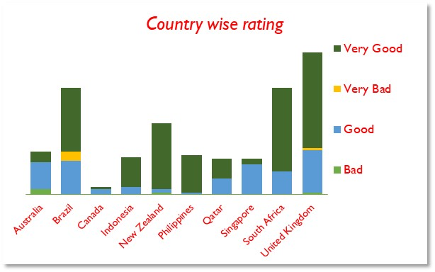
Countries left after exclusion
Canada
Qatar
Singapore
Indonesia
Philippines
Australia
New Zealand
South Africa
Brazil & United Kingdom are two countries where people have given Very Bad rating.
Because of this we can consider people in these two countries are not so restaurant friendly.
Therefore, we can exclude Brazil & United Kingdom.

Slide 11
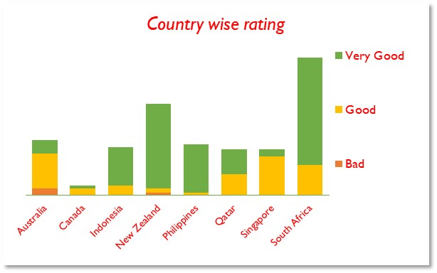
Countries left after exclusion
Canada
Singapore
Australia
From the chart it is clearly visible that Australia, Canada, Singapore are three countries where number of restaurants with very good rating is extremely low. Rest all the countries have high number of restaurants with very good rating that creates a highly cluttered market.
From this insight we can consider that Australia, Canada & Singapore are three countries where there is demand for restaurants with very good rating.
So, we will exclude rest all the countries

Slide 12
After doing extensive analysis I will suggest below three countries for opening restaurants.
Canada
Singapore
Australia

Slide 13
Analysis of Cities
Now as we have selected countries its time to do further analysis for finding cities.
I will try to find cities based on number of restaurants, ratings of restaurants, expenditure on food etc.

Slide 14
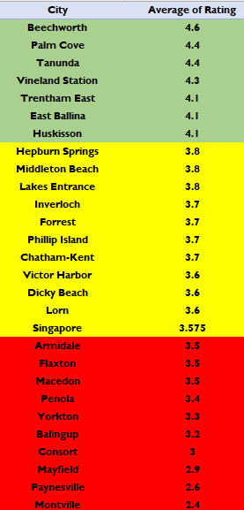
Analysis of cities based on average rating
Cities in green colour have rating of more than 4. If we open restaurants in these cities, we have to face tough competition from existing restaurants of these cities.
Cities in red colour have a rating of less than 3.5. From this we can assume that these cities are not so much restaurant friendly.
Cities in yellow colour have a rating of greater than 3.5 but less than 4. From this we can consider that these cities have scope of opening new restaurants.
We will do further analysis on cities in yellow colour range

Slide 15
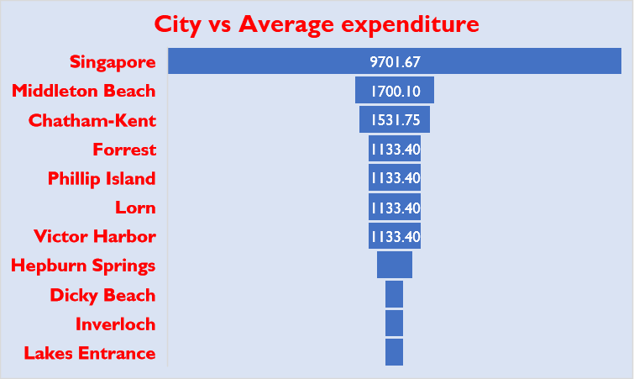
Cities left after exclusion
Singapore
Middleton Beach
Chatham-Kent
From the chart it is clearly visible that Singapore, Middleton Beach & Chatham-Kent are 3 cities where cost for 2 in rupees is maximum.
Because of the exceptionally low cost, achieving break-even might pose a challenge.
So, we will select top 3 cities Singapore, Middleton Beach & Chatham-Kent

Slide 16
After doing extensive analysis I will suggest below three cities for opening restaurants.
Singapore
Middleton Beach
Chatham-Kent

Slide 17
Further deep diving
As I have selected states & cities, I will start further analysis on below mentioned points.
Cuisines
Online delivery
Expenditure on food
Ratings of restaurants
Competitor analysis

Slide 18
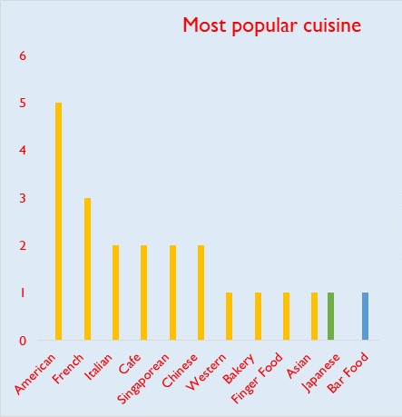
Cuisine analysis
From the chart we can consider that most common cuisine of my recommended cities.
Singapore : American & French
Middleton Beach : Bar Food
Chatham-Kent : Japanese

Slide 19
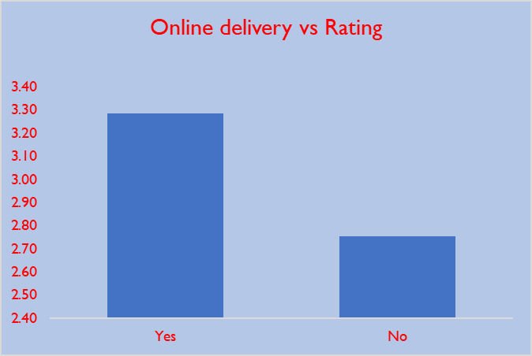
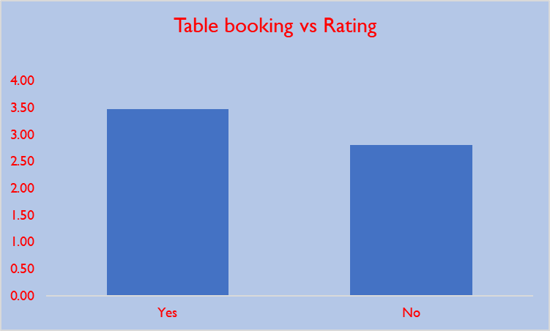
Online delivery & table booking
From below chart it is clearly visible that restaurants with online delivery has greater rating.
From below chart it is clearly visible that restaurants with table booking facility has received greater rating.

Slide 20
Conclusion
Countries to be considered
Canada
Singapore
Australia
Cities to be considered
Chatham-Kent
Middleton Beach
Chatham-Kent

Slide 21
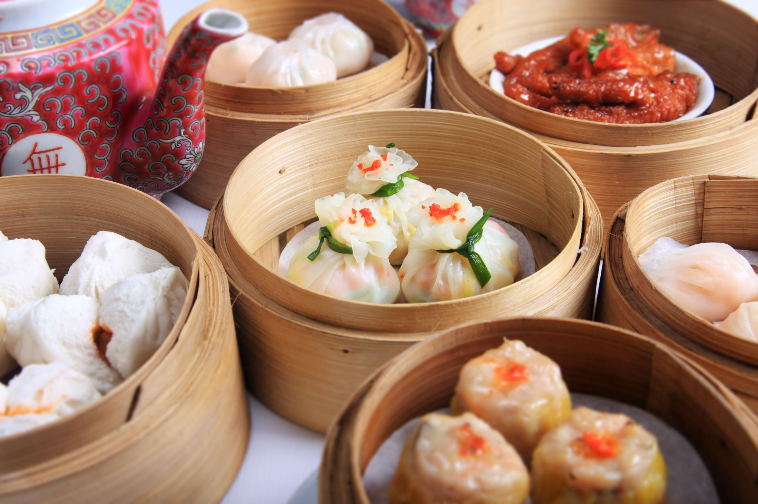
Conclusion
I will recommend to serve following cuisines
Singapore : American & French
Middleton Beach : Bar Food
Chatham-Kent : Japanese
I will recommend to provide online booking
I will suggest to have table booking facility
Correlation between rating & cost in rupees is 0.33. Therefore, I will suggest to keep price competitive

Slide 22
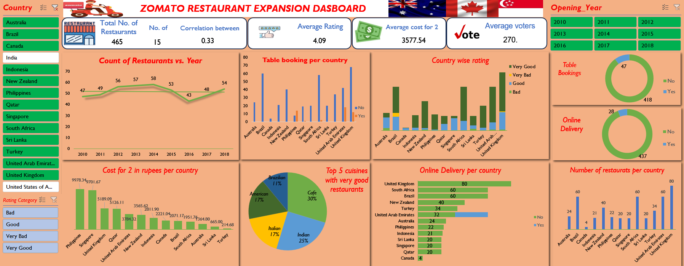

Slide 23

Thank You
Sukhendu Senapati
7003452544
Sukhendu.senapati94@gmail.com

